Slide 1
CDB3033N :
Database
Programming
Prepared by Jay Ch’ng

Slide 2
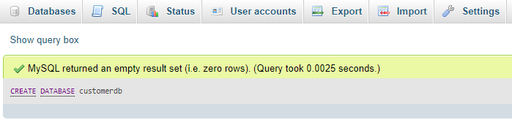
CDB3033N
Database Programming
Create MySQL Database
The CREATE DATABASE statement is used to create a new SQL database.
SQL:
CREATE DATABASE customerdb;

Slide 3
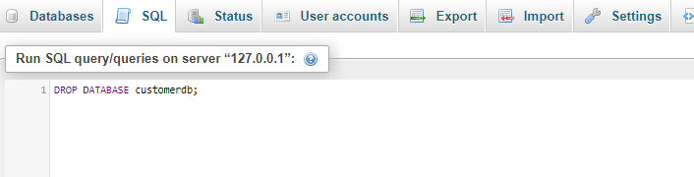
CDB3033N
Database Programming
Drop MySQL Database
The DROP DATABASE statement is used to drop/remove an existing SQL database.
SQL:
DROP DATABASE customerdb;

Slide 4
CDB3033N
Database Programming
Create MySQL Table With Primary Key
NOT NULL
Each row must contain a value for that column (cannot empty), null values are not allowed
DEFAULT
The CREATE TABLE statement is used to create a new SQL table.
Set a default value that is added when no other value is passed
UNSIGNED
SQL:
Used for number types, limits the stored data to positive numbers and zero (no negative number)
CREATE TABLE customers (
id INT UNSIGNED AUTO_INCREMENT PRIMARY KEY,
first_name VARCHAR(255) NOT NULL,
last_name VARCHAR(255) NOT NULL,
email VARCHAR(255),
reg_date DATETIME DEFAULT CURRENT_TIMESTAMP
);
AUTO INCREMENT
MySQL automatically increases the value of the field by 1 each time a new record is added
PRIMARY KEY
Used to uniquely identify the rows in a table. The column with PRIMARY KEY setting is often an ID number, and is often used with AUTO_INCREMENT

Slide 5
CDB3033N
Database Programming
Benefits of Primary Key
Helps identify unique data, such as a customer ID
Prevents duplication of records in a table
Helps with updating or deleting only specific records
Helps ensure that fields aren't null
Helps set up relationships between tables
Ensures row-level accessibility
Improved performance in data retrieval

Slide 6
CDB3033N
Database Programming
Create MySQL Table With Foreign Key
A FOREIGN KEY is a field (or collection of fields) in one table, that refers to the PRIMARY KEY in another table.
The table with the foreign key is called the child table, and the table with the primary key is called the referenced or parent table.
SQL:
CREATE TABLE address (
addr_id INT UNSIGNED AUTO_INCREMENT PRIMARY KEY,
addr_one VARCHAR(255) NOT NULL,
addr_street VARCHAR(255) NOT NULL,
addr_postcost VARCHAR(10) NOT NULL,
addr_country VARCHAR(50) NOT NULL,
cus_id INT UNSIGNED NOT NULL,
FOREIGN KEY (cus_id) REFERENCES customers(id)
);
Benefits of Foreign Key
Improved performance in data retrieval
Defining the relationship between tables
Easier data update/removal

Slide 7
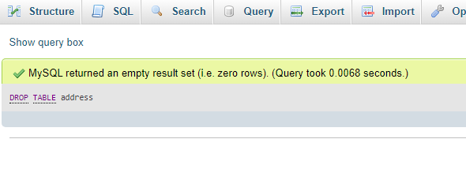
CDB3033N
Database Programming
Drop MySQL Table
The DROP TABLE statement is used to drop/remove an existing table in a database.
SQL:
DROP TABLE address;

Slide 8
CDB3033N
Database Programming
SELECT Statement
The SELECT statement is used to retrieve data from existing table in a database.
Example 1
Example 2
Example 3
Return all the columns from the
Customers table:
Return specific data from the Customers table:
Return full name by combine first name & last name from the Customers table:
SQL:
SQL:
SQL:
SELECT * FROM customers;
SELECT id, first_name, email
FROM customers;
SELECT id, CONCAT(first_name, ' ', last_name) as full_name, email FROM customers;

Slide 9
CDB3033N
Database Programming
SELECT Statement With Condition - WHERE Clause
Example 1
Example 2
Return customer data with email address filtering:
Return customer data with customer id filtering:
SQL:
SQL:
SELECT * FROM customers WHERE email='lihsu@gmail.com';
SELECT * FROM customers WHERE id='5'

Slide 10
CDB3033N
Database Programming
SELECT Statement With Condition – AND, OR & NOT Operators
Example 1
Example 2
Example 3
Return customer data if all the conditions separated by AND are TRUE.
Return customer data if any of the conditions separated by OR is TRUE.
Return customer data if the condition(s) is NOT TRUE or exclude the data.
SQL:
SQL:
SQL:
SELECT * FROM customers WHERE first_name = 'Xin' AND last_name = 'Qian Lu'
SELECT * FROM customers WHERE last_name = 'Wei Lin' OR last_name = 'Zhi Yang'
SELECT * FROM `customers` WHERE NOT last_name = 'Zi Lu'
OR
SELECT * FROM `customers` WHERE last_name != 'Zi Lu'

Slide 11
CDB3033N
Database Programming
SELECT Statement With Condition – ORDER BY Keyword
Example
The ORDER BY keyword is used to sort the result-set in ascending (ASC) or descending (DESC) order.
SQL:
SELECT * FROM `customers` ORDER BY first_name ASC
OR
SELECT * FROM `customers` WHERE last_name != 'Qian Lu' ORDER BY first_name DESC

Slide 12
CDB3033N
Database Programming
SELECT Statement With Condition – LIKE Operator
SQL | Explanation
SELECT * FROM `customers` WHERE last_name LIKE 'z%' | Finds any values that start with "z"
SELECT * FROM `customers` WHERE last_name LIKE '%u' | Finds any values that end with "u"
SELECT * FROM `customers` WHERE last_name LIKE '%z%' | Finds any values that appear in any position
SELECT * FROM `customers` WHERE first_name LIKE '_i%' | Finds any values that have "i" in the second position
SELECT * FROM `customers` WHERE last_name LIKE '%H__' | Finds any values that end with "H" and are at least 3 characters in length
SELECT * FROM `customers` WHERE last_name LIKE 'z%g' | Finds any values that start with "z" and ends with "g"
The LIKE operator is used in a WHERE clause to search for a specified pattern in a column.
There are two wildcards:
The percent sign (%) : wildcard matches any string of zero or more characters.
The underscore sign (_) : wildcard matches any single character.

Slide 13
Q & A
Prepared by Jay Ch’ng

Slide 14
Assignment Discussion
Prepared by Jay Ch’ng

